Slide 1
Causes and Consequences of
Environmental Degradation

Slide 2
Overpopulation
World population - exponential growth
  1 billion in 1800
  2.5 billion in 1950
  6 billion in 2000
  7 billion in 2011

Slide 3
Overpopulation
Africa, Asia, and Latin America primarily affected
Causes:
  Poverty
  Women’s rights issues
    impaired access to reproductive health care and education
    political/legal/economic/social marginalization

Slide 4

Air Pollution

Slide 5
Health Effects of Air Pollution
Causes approximately 60,000 - 75,000 premature deaths/yr. in U.S.
656,000 in China
Over 2 million worldwide

Slide 6
Health Effects of Air Pollution
MI
CHF
Ventricular arrythmias
Asthma/COPD
PVD
Cerebrovascular disease
Multiple other illnesses

Slide 7
Air Pollution
Indoor combustion of coal and biomass for cooking, heating and food preservation
  3 billion people worldwide
  2 million deaths/yr
Tobacco smoke
  5.4 million deaths/yr worldwide (1/10 deaths)

Slide 8
Air Pollution: The Good News
Reductions in air pollution under Clean Air Act Account for up to 15% of overall increase in life expectancy in major U.S. metropolitan areas
  Saved 160,000 lives in 2010

Slide 9
Effects of Ozone Destruction
Ozone hole over Antarctic (2½X size of Europe)
  Shrinking
Increased cataracts (UV damage)
Increased lifetime melanoma risk
  1/1500 - 1930
  1/68 - today

Slide 10
US Energy Consumption by Fuel
Oil – 37% - peak oil production expected 2014
Natural gas – 24%
Coal – 22% - peak coal production 1920
Nuclear – 8.5%
Renewables (mostly hydroelectric and biomass; small amounts of geothermal, wind, and solar) – 7.3%

Slide 11
Toxins/Pesticides
6 trillion tons of over 85,000 chemicals produced annually
  More than 90% have never been screened for toxicity
5 billion lbs/yr pesticides worldwide
  1.1 billion lbs/yr in U.S.
  About 3 lbs/person/yr in U.S.

Slide 12
Pesticides
EPA: U.S. farm workers suffer up to 300,000 pesticide-related acute illnesses and injuries per year
  25 million cases/yr worldwide
NAS: Pesticides in food could cause up to 1 million cancers in the current generation of Americans
WHO: 1,000,000 people killed by pesticides over the last 6 years

Slide 13
Health Effects of Pesticides
Autism
Parkinson’s Disease
Alzheimer’s disease
Diabetes
Obesity (with prenatal exposure)
Depression
ADHD
Endocrine/reproductive effects

Slide 14
Toxic Pollutants
85,000 known or suspected hazardous waste sites in the U.S.
Environmental Racism
  Waste dumps/incinerators more common in lower SES neighborhoods
    “Cancer Belt” (Baton Rogue to New Orleans)

Slide 15
Infamous Industrial Disasters
Minimata, Japan
Love Canal
Bhopal, India
Chernobyl, USSR

Slide 16
Infamous Industrial Disasters
Alaska, Exxon Valdez, 1989
2006 BP Alaskan pipeline rupture
2010 BP Gulf disaster
2011 – Yellowstone pipe rupture

Slide 17
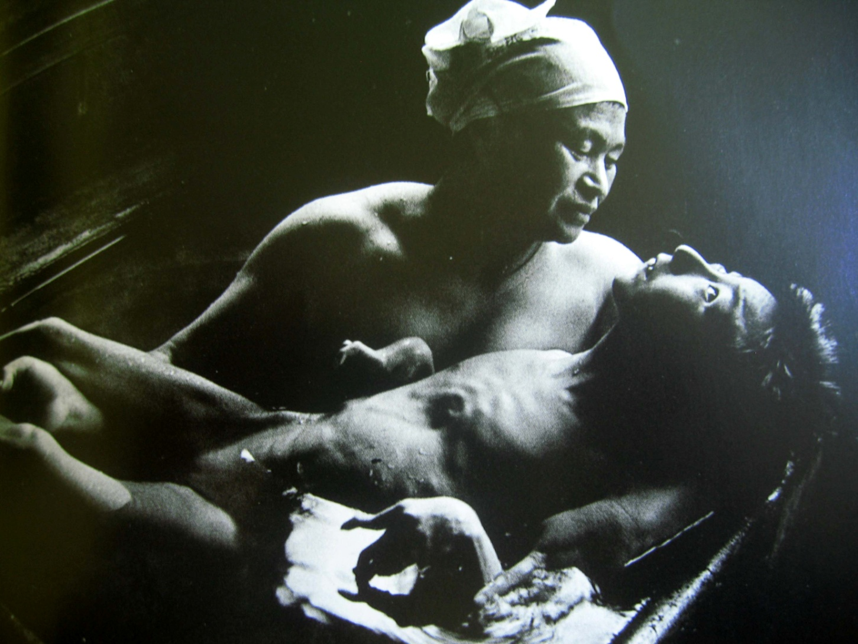
Minimata Disease
W Eugene Smith

Slide 18
Deforestation
Tropical forests constitute 7% of land surface area, contain > 50% of plant and animal species
Majority of tropical forests destroyed
One acre of world’s forest cut down every second
50% of global wetlands destroyed (54% in U.S.)

Slide 20
Deforestation: Causes
New agricultural settlements (overpopulation, poverty, unsustainable farming practices)
Logging
Oil and gas exploration
Cattle ranching
Drug cultivation

Slide 21
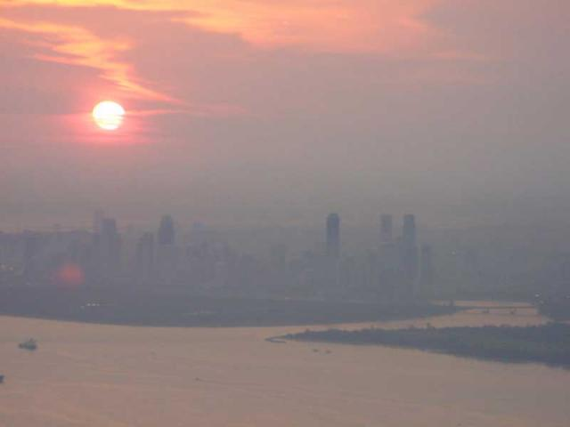
Global Warming

Slide 22
Consequences of Global Warming
160,000 deaths and 5.5 million disability-adjusted life years lost per year
  WHO, UN Environment Program
  Expected to double by 2020

Slide 23
Consequences of Global Warming
Polar icecaps/glaciers/Greenland ice sheet/Himalayas/permafrost melting, sea levels rising
↑ weather extremes/natural disasters/insurance claims
  ↑ infectious diseases

Slide 24
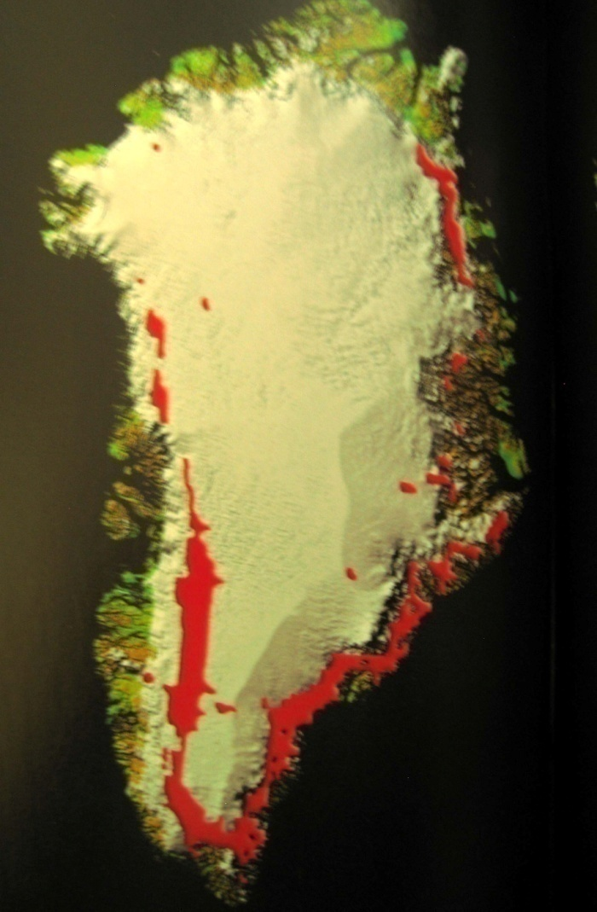
Greenland’s Ice Cap Melting: 1992

Slide 25
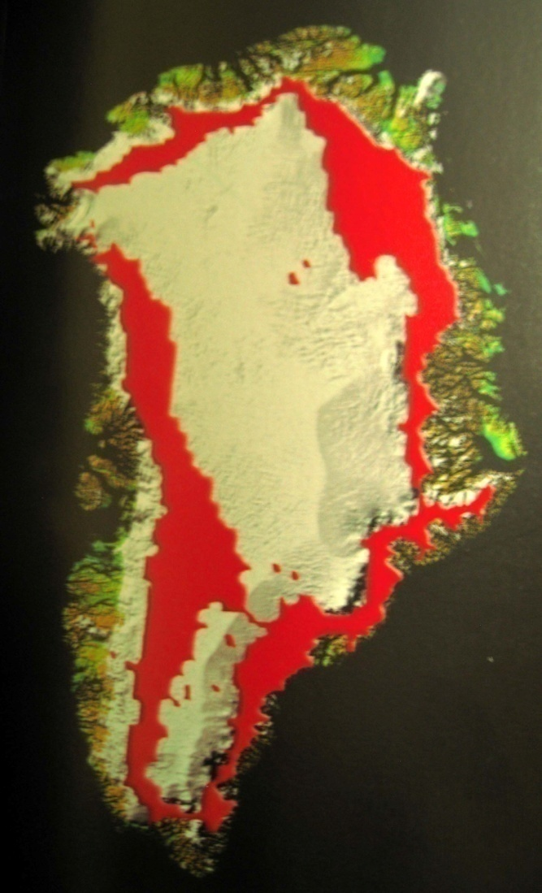
Greenland’s Ice Cap Melting: 2002

Slide 26
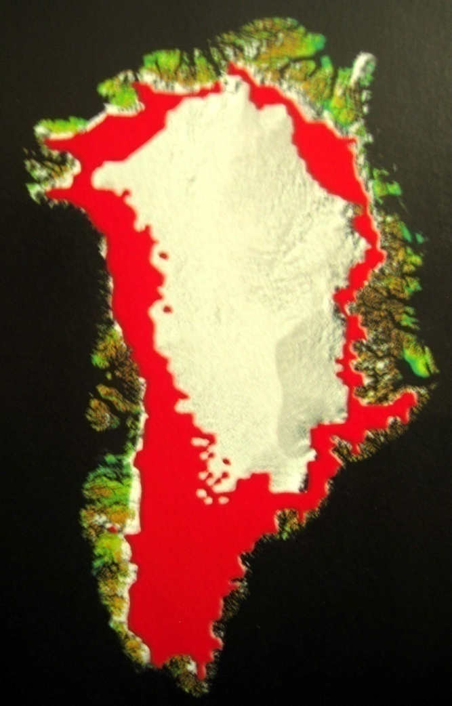
Greenland’s Ice Cap Melting: 2005

Slide 27
Global Warming
The top 1/5 of the world’s largest 145 countries account for 63% of global C0₂ emissions (lowest 1/5 = 2%)
Countries most affected are those least responsible
Climate refugees
  Disappearing locales: Tuvalu, Vanuatu, Kivalina (Alaska), Male (Maldives)

Slide 28
Agriculture
Global per capita cropland down over 50% from 1961 to present
Soil erosion exceeds soil formation
Decreasing crop diversity/genetic diversity
  Consequences: vulnerability to disease, huge crop losses (e.g., Irish potato famine)

Slide 29
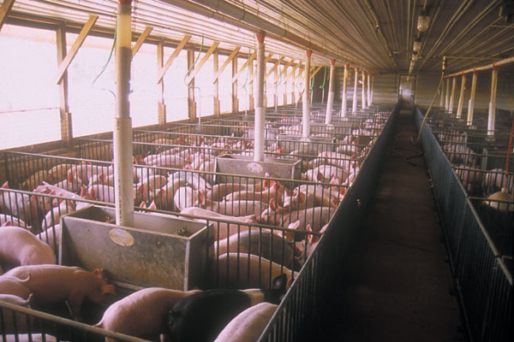
Factory Farming

Slide 30
Factory Farming
Factory farms have replaced industrial factories as the # 1 polluters of American waterways
Agriculture accounts for 70% of U.S. antibiotic use
CDC: “Antibiotic use in food animals is the dominant source of antibiotic resistance among food-borne pathogens.”

Slide 31
Overfishing
Fisheries collapsing
Coral reef destruction
Aquaculture

Slide 32
Species Loss
Rate of extinction = 4,000-6,000 species/year
1,000 - 10,000X background rate of extinction

Slide 33
Causes of Species Loss
Habitat loss (overpopulation, logging, etc.)
Environmental pollution
Global warming
Exotic species invasions
Overhunting
Black market in endangered animals
HUMANS

Slide 35
Maldistribution of Wealth
U.S: Richest 1% of the population owns 50% of the country’s wealth
-poorest 90% own 30%
-widest gap of any industrialized nation
  Associated with 880,000 deaths per year over expected number if gap was same as in Western European nations

Slide 36
Maldistribution of wealth
  Less than 4% of the combined wealth of the 225 richest individuals in the world would pay for ongoing access to basic education, health care (including reproductive health care), adequate food, safe water, and adequate sanitation for all humans (UNDP)

Slide 37
Declaration of Independence
“All men are created equal.”

Slide 41
Maldistribution of Wealth/Resources Threatens National Security and Requires a Permanent War Economy
“The U.S. has about 50% of the world’s wealth, but only 6.3% of its population. This situation cannot fail to be the object of envy and resentment. Our real task in the coming period is to devise a pattern of relationships which will permit us to maintain this position of disparity withoug positive detriment to our national security.”
  George Kennan, U.S. State Dept. Policy Planning Study, 1948

Slide 42
Racial Disparities
Economic
Educational
Criminal justice system involvement
Discrimination

Slide 43
Racial Disparities: Health Care
Higher maternal and infant mortality
Higher death rates for most diseases
Shorter life expectancies
Less health insurance
Fewer diagnostic tests / therapeutic procedures

Slide 44
Racial Disparities: Health Care
Equalizing the mortality rates of whites and African-Americans would have averted 686,202 deaths between 1991 and 2000
  Whereas medical advances averted 176,633 deaths
    AJPH 2004;94:2078-2081

Slide 45
Overconsumption (Affluenza)
U.S. = 6.3% of world’s population
  Own 50% of the world’s wealth
U.S. responsible for:
-25% of world’s energy consumption
-33% of paper use
-72% of hazardous waste production
(1 ton/person/year)

Slide 46
Economic Injustices
The Third World Debt Crisis
  Africa/Latin America/Asia - $300 billion
Unfair economic organizations and trade agreements
  WTO, IMF, GATT, NAFTA, others
Child labor
↓ Unionization
Unsafe working conditions

Slide 47
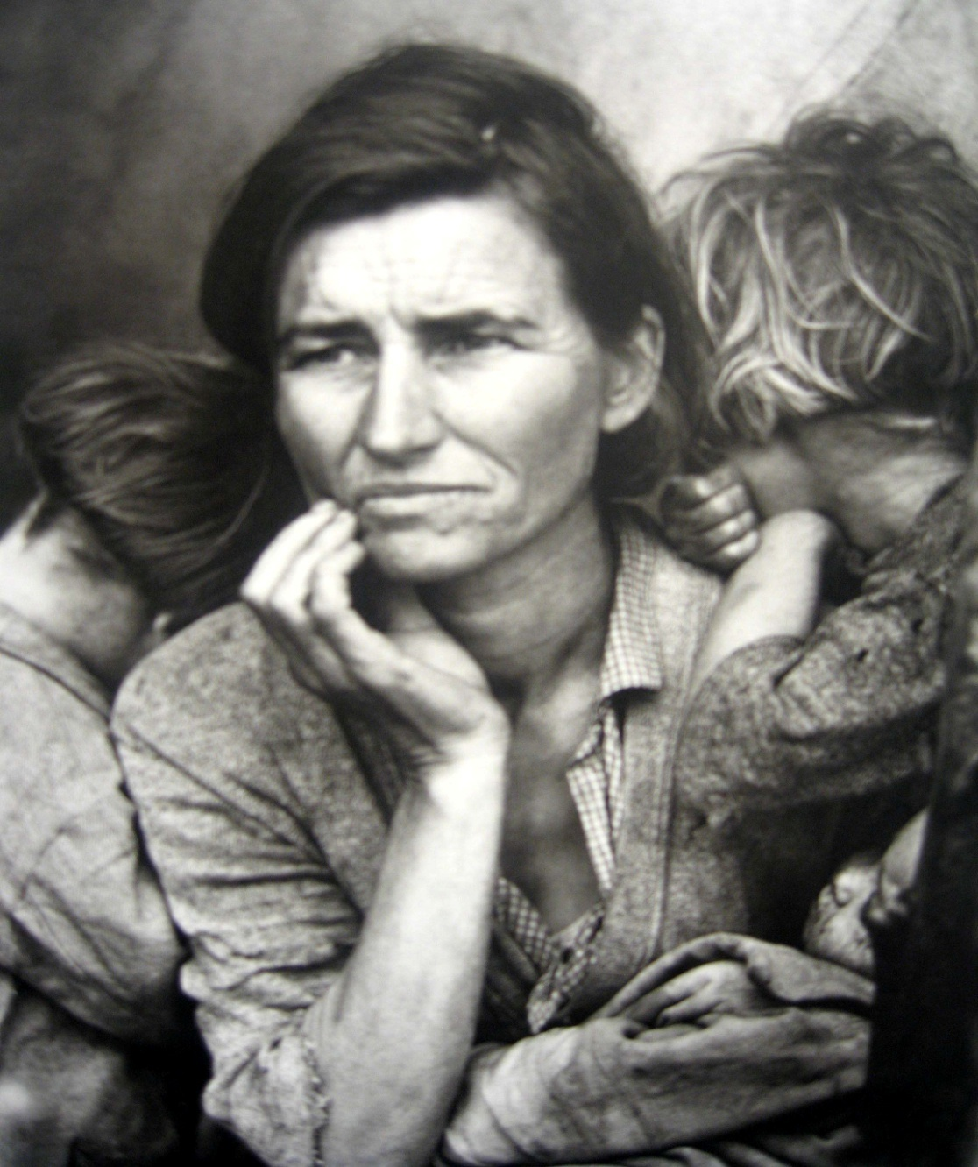

Slide 48
Poverty and Hunger
US: 14% of residents and 20% of children live in poverty
  Rates of poverty in Blacks and Hispanics = almost 3X Whites
17% (52 million people) lack health insurance (2011)
Poverty associated with worse physical and mental health

Slide 49
Poverty
1.1 billion people lack access to safe, clean drinking water
-1.8 million child deaths/year
2 billion have no electricity
2.6 billion do not have adequate sanitation services
Lack of clean water and sanitation cause 4 billion cases of diarrhea and 1.6 million deaths per year

Slide 50
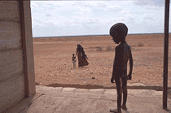
Famine

Slide 51
Famine
1.5 billion malnourished
Hunger kills 18,000 people per day, most under age 5
Hunger-related causes kill as many people in 8 days as the atomic bomb killed at Hiroshima

Slide 52
Poverty and Priorities
Amount of money needed each year (in addition to current expenditures) to provide water and sanitation for all people in developing nations = $9 billion
Amount of money spent annually on cosmetics in the U.S. = $8 billion

Slide 53
Poverty and Priorities
Amount of money needed each year ( in addition to current expenditures) to provide reproductive health care for all women in developing countries = $12 billion
Amount of money spent annually on perfumes in Europe and the U.S. = $12 billion

Slide 54
Medical Care
50% of global health care budget spent in the U.S.
Per capita expenditure on health care:
  U.S. = $8,160
  Typical poor African/Asian country = $5-10

Slide 55
Would You Sign a Petition to Ban Dihydrogen Monoxide?
1. It can cause excessive sweating and vomiting
2. It is a major component in acid rain
3. It can cause severe burns in its gaseous state
4. It can kill you if accidentally inhaled
5. It contributes to erosion
6. It decreases effectiveness of automobile brakes
7. It has been found in tumors of terminal cancer
patients

Slide 56
International Non-Cooperation/Isolationism
Failure to sign or approve:
  Kyoto Protocol on Climate Change
  International Covenant on Economic, Social, and Cultural Rights
  Convention on the Prohibition of Anti-Personnel Land Mines

Slide 57
Solutions
Stronger environmental laws
Restructure tax system
Renewable energy
More equitable distribution of medical research funds and health care dollars
Single payer health care (PHM/PHC)

Slide 58
Günter Grass
“The first job of a citizen is to keep your mouth open.”

Slide 59
Anita Roddick
"If you think you are too small to have an impact, try going to bed with a mosquito in your tent"

